Slide 1
An Introduction to Julia
Talha Hanif Butt

Slide 2
Why
Scientists communicate with math symbols.
You don’t code the math, code is the math.
Fast and easy to code.

Slide 3
Why
Composability
Intent of the programmer is clear.
It’s easier to understand what’s going on in the code.
People from different fields can work together on a code base.

Slide 4
Vision
As fast as C.
As easy as Python.
As good at statistics as R.
As good at string processing as Perl.
As scalable as Hadoop.

Slide 5
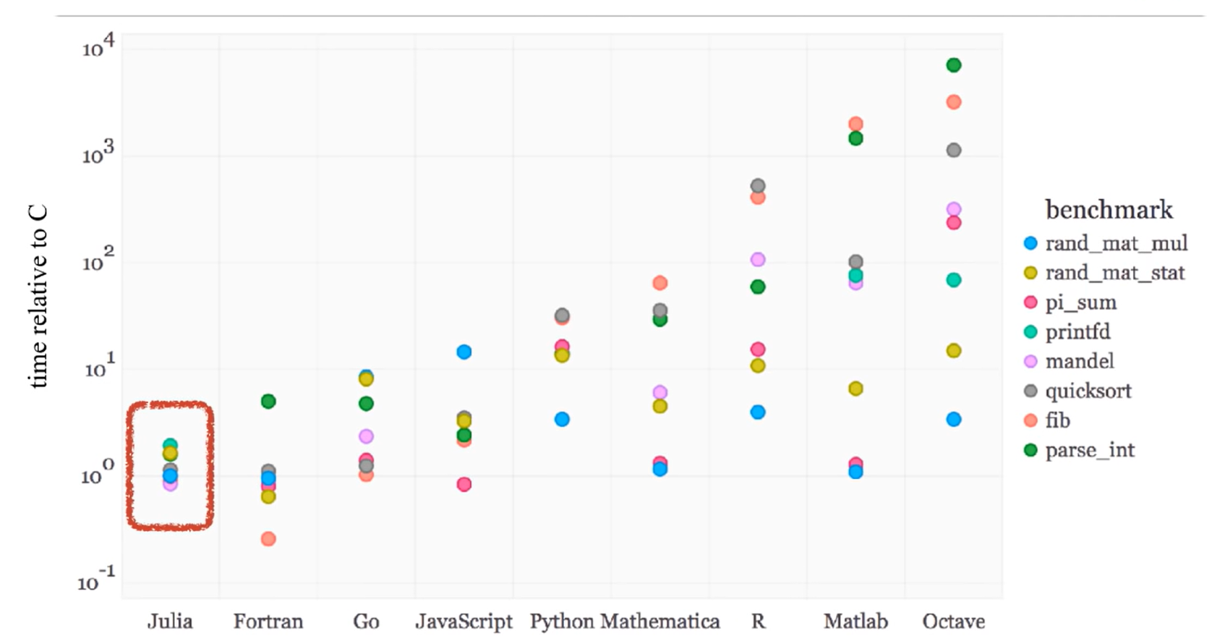
Speed

Slide 6
Installation
Install Jupyter Notebook
Install Julia
Add Julia to Jupyter Notebook

Slide 7
Install Jupyter Notebook
download the Anaconda Distribution for your operating system. Once you are done with the installation, click on the Anaconda Navigator.
From the Anaconda Navigator, you’ll be able to launch Jupyter Notebook by clicking on the Launch button within the Jupyter box.

Slide 8
Install Julia and add it to Jupyter Notebook
Download Julia through this.
Install it.
Open the Julia command line and write:
using Pkg
Press Enter
Then type:
Pkg.add(“IJulia”)
Press Enter
Wait for the installation to complete.

Slide 9
Install Julia and add it to Jupyter Notebook
Create a new notebook in Jupyter.
Select Julia as the kernel.
Write this command in a cell:
println(“Hello World”)
Run the cell.

Slide 10
Getting Started
How to print
How to assign variables
How to comment
Syntax for basic math

Slide 11
Strings
How to get a string
String interpolation
String concatenation

Slide 12
Data Structures
Dictionaries
Tuples
Arrays

Slide 13
Loops
While
For

Slide 14
Conditionals
If
else
ternary operator

Slide 15
Functions
How to declare a function
Duck-typing in Julia
Mutating vs. non-mutating functions
Broadcasting

Slide 16
References
A programming language to heal the planet together: Julia | Alan Edelman | TEDxMIT, https://www.youtube.com/watch?v=qGW0GT1rCvs
Julia is killing it in the programming world. Meet its co-creator from India, https://www.youtube.com/watch?v=aMyAHs2c0_w
A Gentle Introduction to Julia, https://www.youtube.com/watch?v=4igzy3bGVkQ&list=RDCMUC9IuUwwE2xdjQUT_LMLONoA&start_radio=1&rv=4igzy3bGVkQ&t=4
How to Add Julia to Jupyter Notebook, https://datatofish.com/add-julia-to-jupyter/
https://github.com/JuliaAcademy/Introduction-to-Julia
https://github.com/JuliaAcademy/DataScience
https://www.youtube.com/watch?v=AAGxWEJ_eWk&list=PLP8iPy9hna6QuDTt11Xxonnfal91JhqjO&index=4

