Slide 1
Wednesday
10 November 2021

Slide 2
What is PyTorch?
PyTorch is an open source machine learning library that specializes in tensor computations, automatic differentiation, and GPU acceleration. For those reasons, PyTorch is one of the most popular deep learning libraries.
PyTorch tends to be especially popular among the research community due to its Pythonic nature and ease of extendability (i.e., implementing custom layer types, network architectures, etc.).

Slide 3
Some important properties of PyTorch are:
There’s a large and vibrant community at PyTorch.org community with excellent documentation and tutorials. The forums are active and supportive.
It’s written in Python and integrated with popular Python libraries like numpy
It supports CPU, GPU
Easy to debug using Pythons IDE and debugging tools.
It supports cloud platforms

Slide 4
Getting Started with PyTorch
Via Anaconda
conda install -c pytorch pytorch
conda install -c anaconda pytorch-gpu
Via pip:
pip3 install torch

Slide 5
PyTorch Packages

Slide 6
PyTorch Basics: two level of abstraction
Tensor :
Tensors are similar to NumPy’s ndarrays, with the addition being that Tensors can also be used on a GPU to accelerate computing. Common operations for creation and manipulation of these Tensors are similar to those for ndarrays in NumPy. (rand, ones, zeros, indexing, slicing, reshape, transpose, cross product, matrix product, element wise multiplication)
Module:
Base class for all neural network modules, a nueral network layer, may store all state or learnable weights

Slide 7
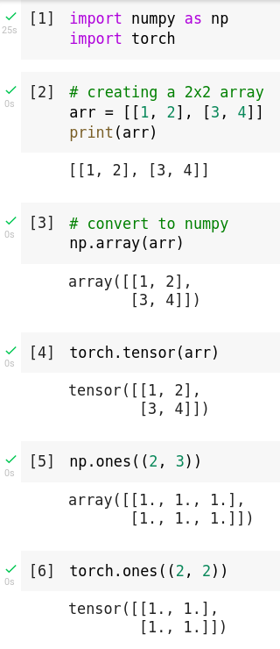
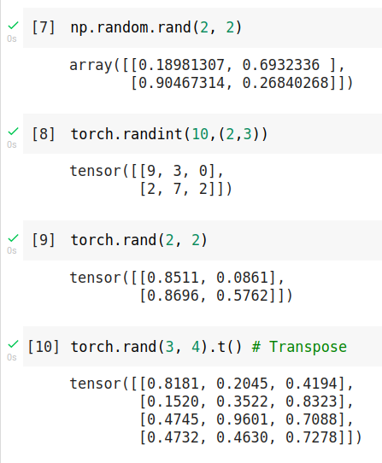
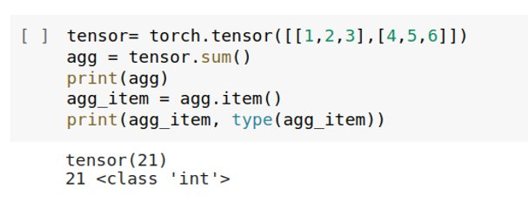
Tensor Basics
If you have a one-element tensor, for example by aggregating all values of a tensor into one value, you can convert it to a Python numerical value using item():

Slide 8
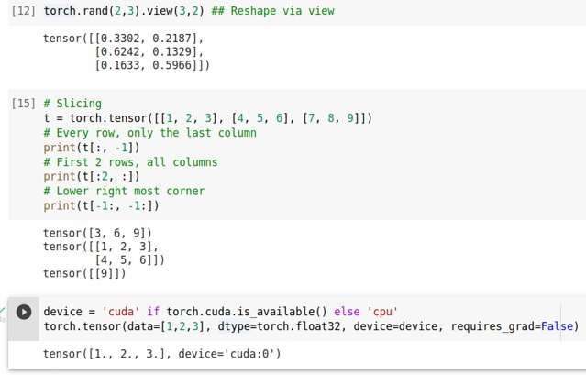
Tensor Basics

Slide 9
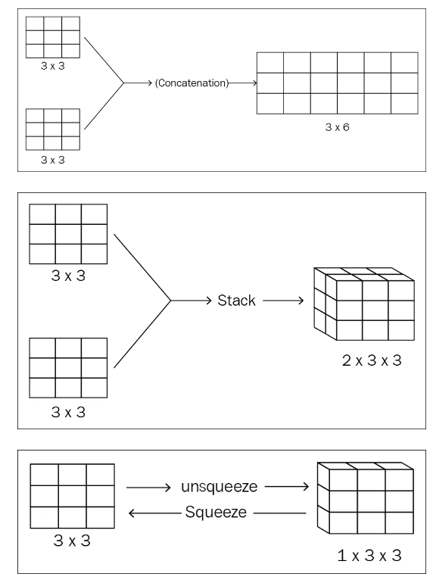
Tensor Basics
Squeeze only works if the size of a given dimension is 1.
*If you want to remove a dimension of size > 1 then you need to use a function to do that reduction like sum or max or mean.
Concatenation , Stack
if A and B are of shape (3, 4), torch.cat([A, B], dim=0) will be of shape (6, 4) and torch.stack([A, B], dim=0) will be of shape (2, 3, 4)

Slide 10
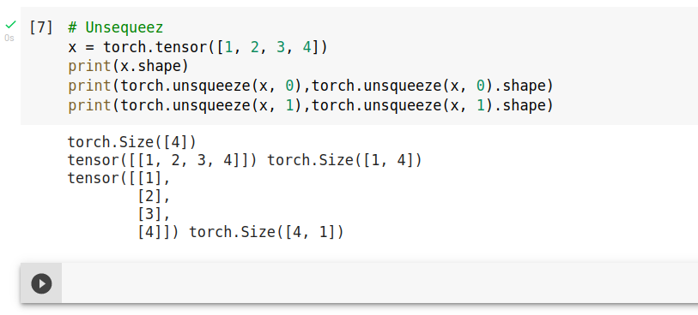
Tensor Basics
Unsequeez
Returns a new tensor with a dimension of size one inserted at the specified position. [...]
torch.unsqueeze adds an additional dimension to the tensor. So let's say you have a tensor of shape (3), if you add a dimension at the 0 position, it will be of shape (1,3), which means 1 row and 3 columns: If you have a 2D tensor of shape (2,2) add add an extra dimension at the 0 position, this will result of the tensor having a shape of (1,2,2), which means one channel, 2 rows and 2 columns. If you add at the 1 position, it will be of shape (2,1,2), so it will have 2 channels, 1 row and 2 columns.

Slide 11
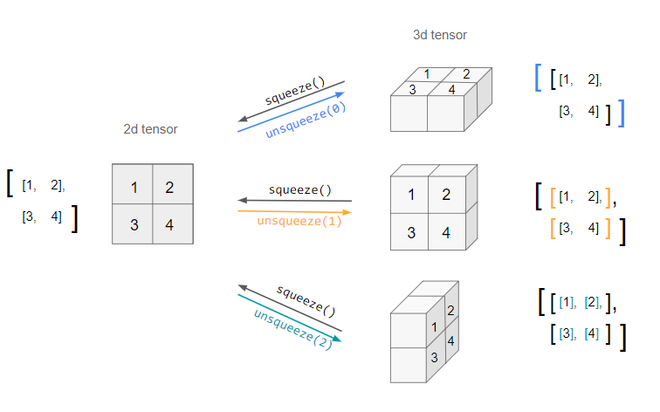
Tensor Basics
sequeez and unsequeez

Slide 12
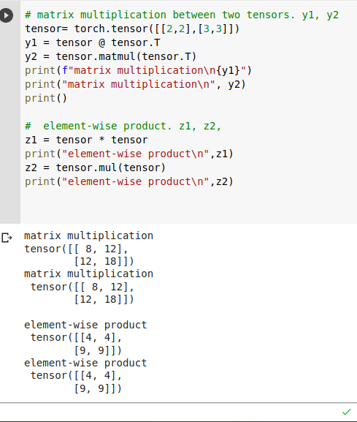
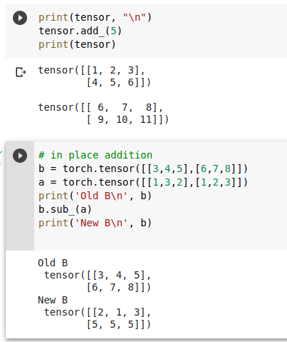
Tensor Basics
In-place operations
This store the result into the operand are called in-place. They are denoted by a _ suffix. For example: x.copy_(y), x.t_(), will change x

Slide 13
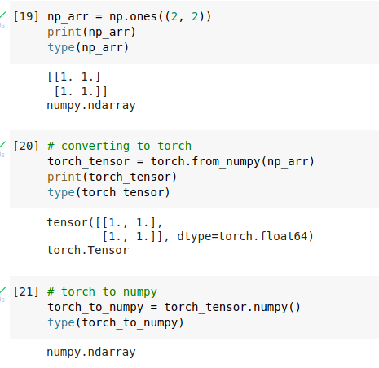
Numpy to Torch Bridge

Slide 14
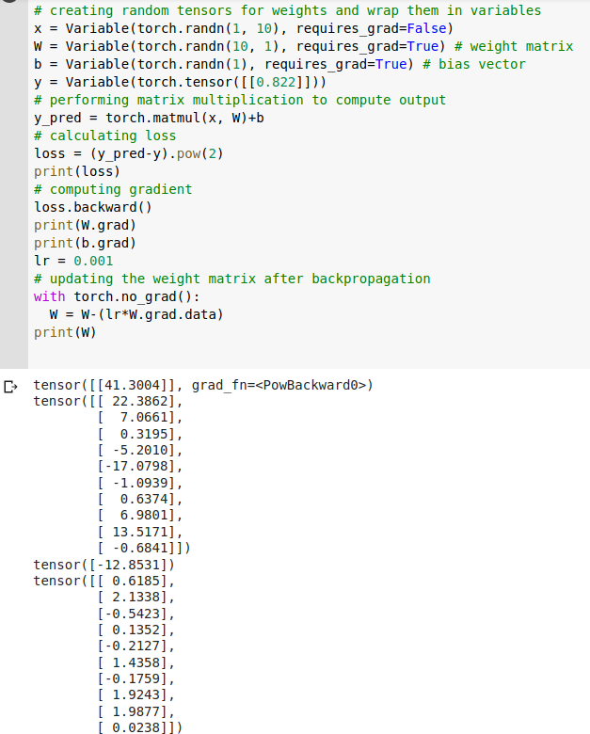
Automatic differentiation package
Autograd is a PyTorch package for the differentiation for all operations on Tensors. It performs the backpropagation starting from a variable. In deep learning, this variable often holds the value of the cost function. Backward executes the backward pass and computes all the backpropagation gradients automatically.
Which tensors are going to be handled by the backward() method applied to the loss?
[b,w,y_pred, loss]
-If a tensor in the list is used to compute another tensor, the latter will also be included in the list.
-Tracking these dependencies is exactly what the dynamic computation graph is doing
with torch.no_grad(): disabled gradient calculation.

Slide 15
Computational Graphs
PyTorch uses a dynamic graph, that means the computational graph is built up dynamically, immediately after we declare variables. This graph is thus rebuilt after each iteration of training
https://algorithmia.com/blog/exploring-the-deep-learning-framework-pytorch

Slide 16
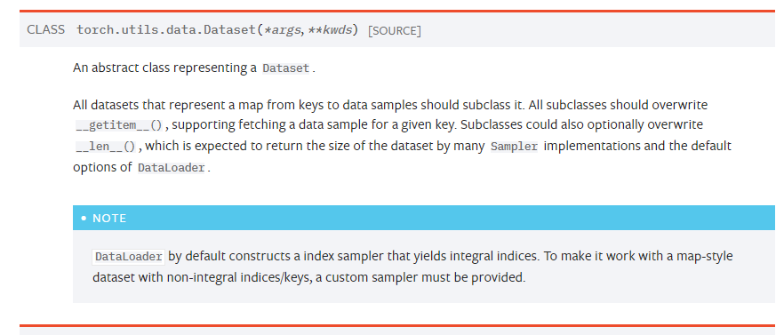
PyTorch Dataset and DataLoader
Dataset and DataLoader classes available in PyTorch for easy batching of training examples. The Dataset stores all your data, and Dataloader is used to iterate through the data, manage batches, transform the data
__init__ This function is called when instantiating the object.
It's typically used to store some essential location like
file-paths and image transforms. __len__ : This function returns the length of the dataset. __getitem__ :This function is responsible for returning a sample from the dataset based on the index provided.

Slide 17
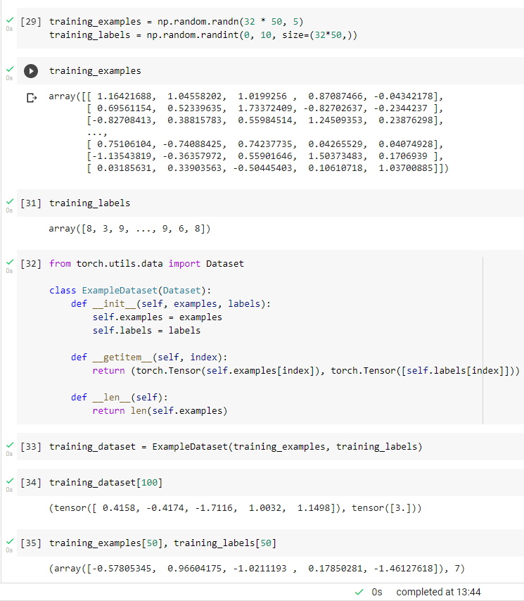
PyTorch Dataset and DataLoader
The Dataset retrieves our dataset’s features and labels one sample at a time. While training a model, we typically want to pass samples in 'minibatches', reshuffle the data at every epoch to reduce model overfitting, and use Python’s multiprocessing to speed up data retrieval.
DataLoader is an iterable that abstracts this complexity for us in an easy API
from torch.utils.data import DataLoader
training_dataloader =DataLoader(training_dataset, batch_size=32, shuffle=True)

Slide 18
Training a Model in PyTorch

Slide 19
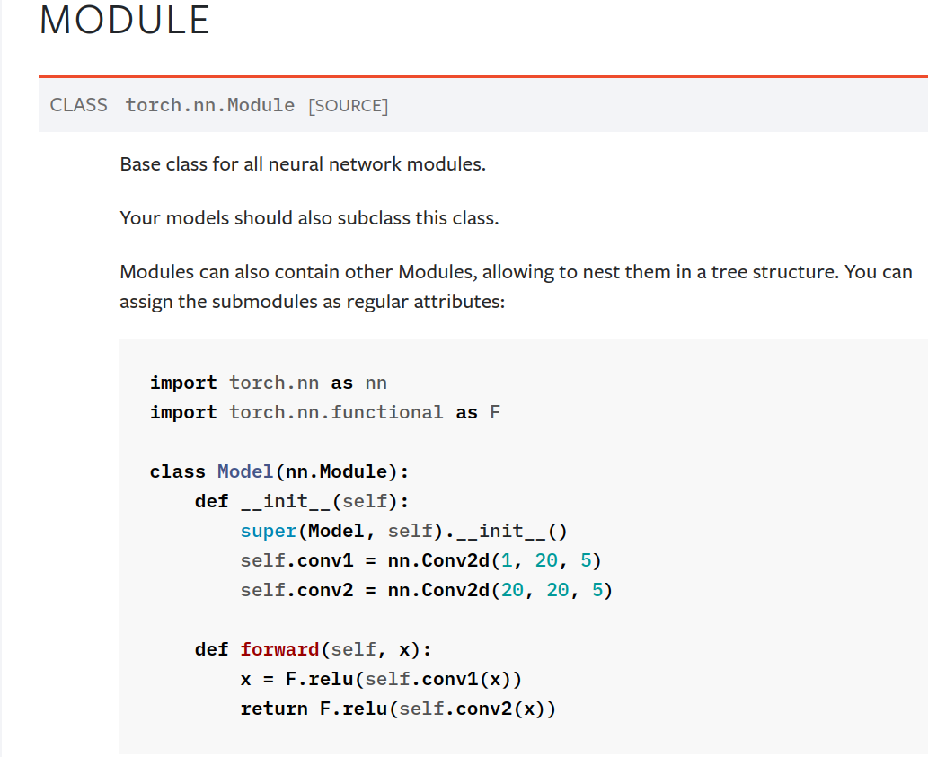
Module in PyTorch

Slide 20
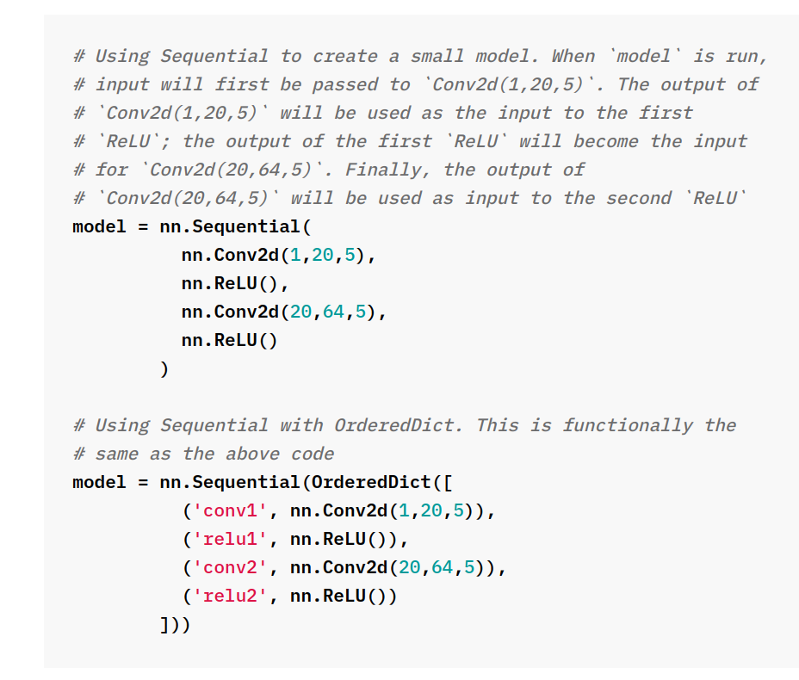
Module in PyTorch

Slide 21
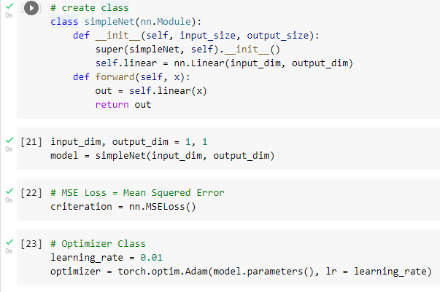
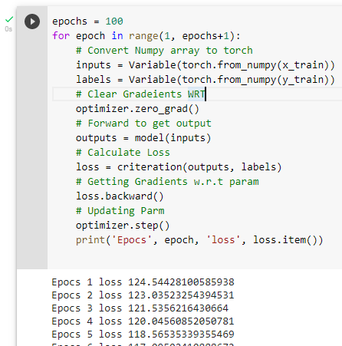
Training a Model in PyTorch

Slide 22
Training a Model in PyTorch
In PyTorch, for every mini-batch during the training phase, we typically want to explicitly set the gradients to zero before starting to do backpropragation (i.e., updating the Weights and biases) because PyTorch accumulates the gradients on subsequent backward passes
The accumulation (i.e., sum) of gradients happens when .backward() is called on the loss tensor

Slide 23
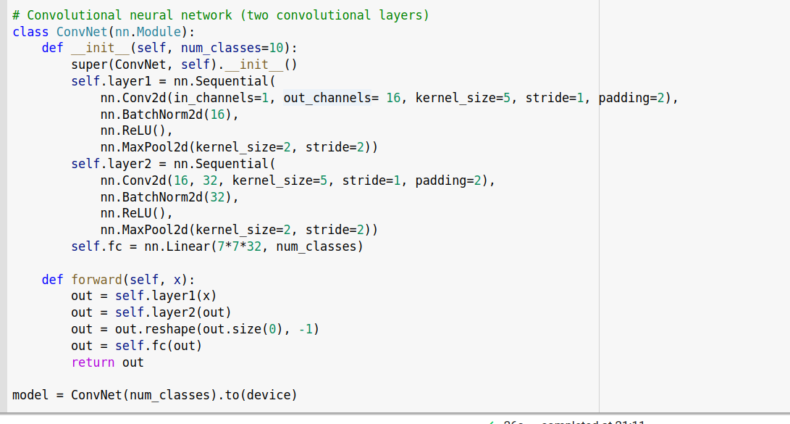
Module in PyTorch

Slide 25
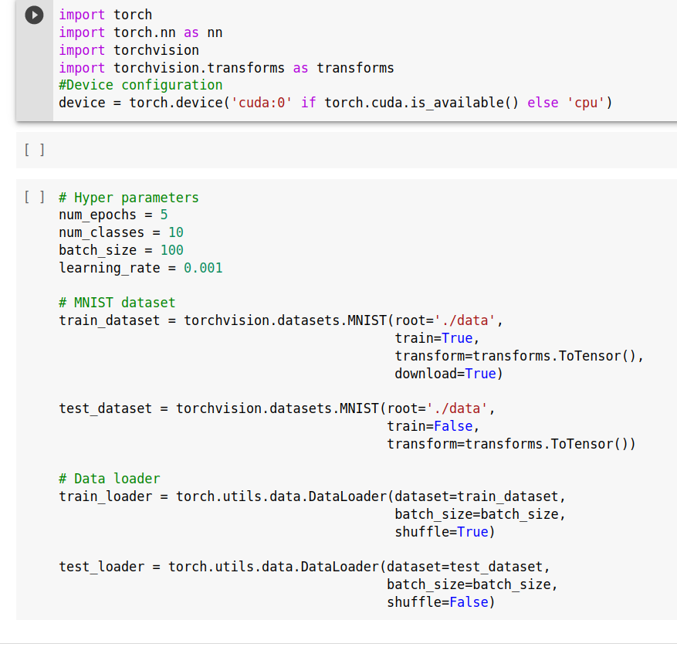
Torchvision

Slide 26
References
https://pytorch.org/assets/deep-learning/Deep-Learning-with-PyTorch.pdf

